Slide 1

vCNN: Verifiable Convolutional Neural
Network based on zk-SNARKs
汇报人：陆涛

Slide 2

P Language and NP Language
Reduction
Review of ZKP
Convolutional Neural Network
Methods in vCNN

Slide 3
P language and NP language
String: ”abc”、“g12dg”
language: A language is a set of strings.
{“abc”, “g12dg”}

Slide 4
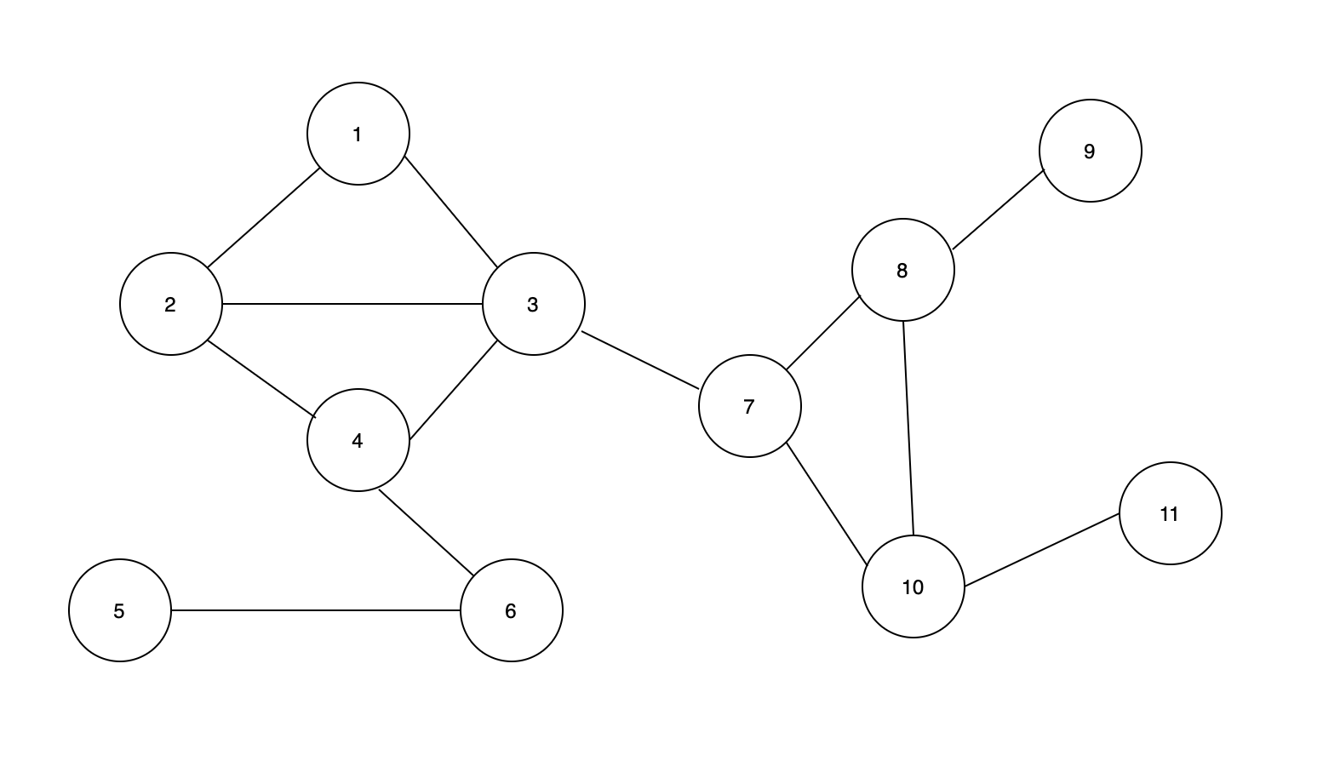
P language and NP language
Graph
<G> = <V, E>

Slide 5
P language and NP language
language: A language is a set of strings.
L1:
{<x, y>| x and y are relatively prime}
L2:
{<G, s, t>| G is a directed graph that has a
directed path from s to t}

Slide 6
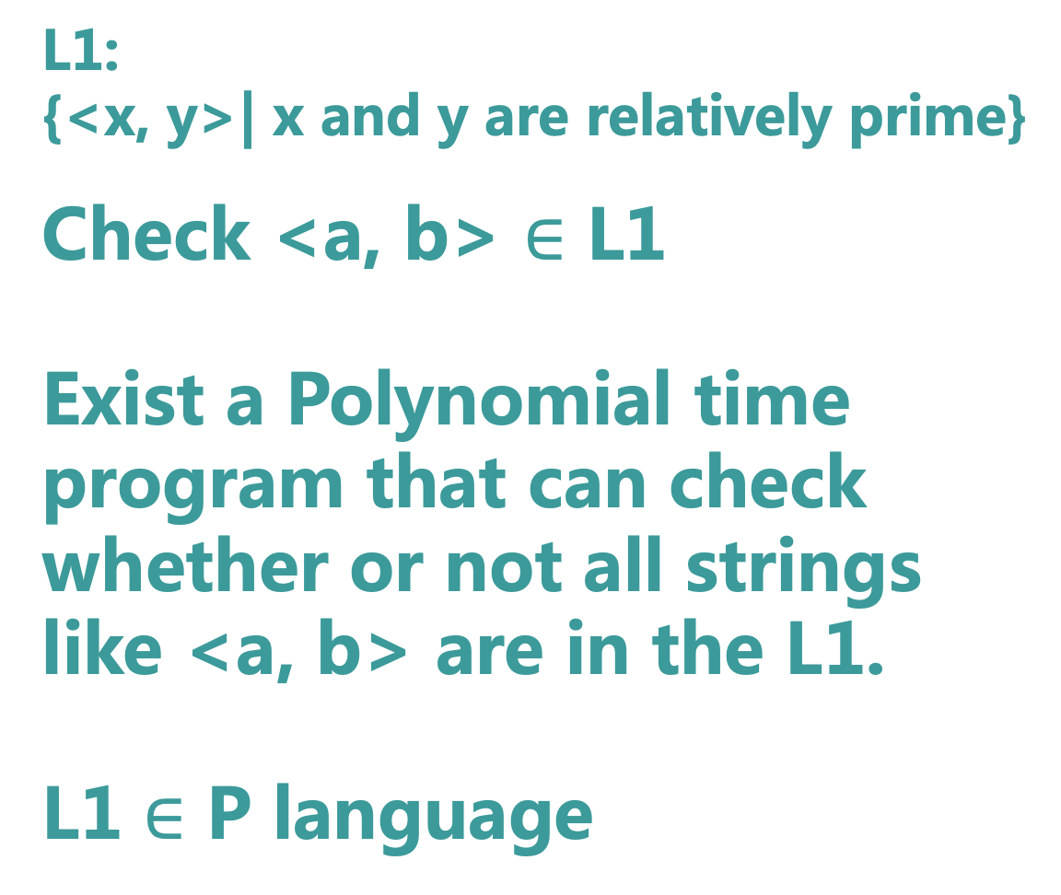
P language and NP language
L1:
{<x, y>| x and y are relatively prime}
Check <a, b> $∈$ L1
Exist a Polynomial time
program that can check
whether or not all strings
like <a, b> are in the L1.
L1 $∈$ P language
Program1:
Input <a, b>
g = gcd(a, b)
if g == 1:
return true
else:
return false

Slide 7
P language and NP language
L1:
{<x, y>| x and y are relatively prime}
Program1:
Input <a, b>
g = gcd(a, b)
if g == 1:
return true
else:
return false
1. Polynomial time： Poly(|<a, b>|)
2. All strings

Slide 8

P language and NP language
Hamiltonian path
L3: {<G, s, t> | G is a directed graph with a Hamiltonian path from s to t}
Exist a Polynomial time program that can check whether or not all strings like <G, s, t> are in the L3 with an auxiliary input w like a Hamiltonian path.
L3 $∈$ N P language

Slide 9
P language and NP language
Hamiltonian path
L3: {<G, s, t> | G is a directed graph with a Hamiltonian path from s to t}
L3:
Statement: x := <G, s, t>
auxiliary input: w := path
Relation:
R(x, w) := w is a directed path that goes through each node exactly once.
(Hamiltonian path)

Slide 10
P language and NP language
All languages in P are in NP
If all statements in one language can be accepted by a polynomial time program. This language belong to P.
All statements in one NP language may be accepted by a polynomial time program.
If there is a language where one statement can be accepted by none of a polynomial time programs, we can prove NP != P

Slide 11
Reduction
杭州
北京
问题1
问题2 如何买一张杭州到北京的飞机票？
问题1 可以规约到 问题2
如果可以解决问题2 就可以解决 问题1

Slide 12
Reduction
L3: {<G, s, t> | G is a directed graph with a Hamiltonian path from s to t}
L4: SAT = {<t>| t is a satisfiable Boolean formula}.
a = (x ^ y) v (~x ^ ~y) in SAT (x = true y = true)
b = (x ^ y) ^ (~x ^ ~y) not in SAT
THEOREM:
If L3 can be reduced to L4 and there is a polynomial time program that can check whether or not a string <t> is in L4, there is a polynomial time program that can check whether a string <G, s, t> is in L3.

Slide 13
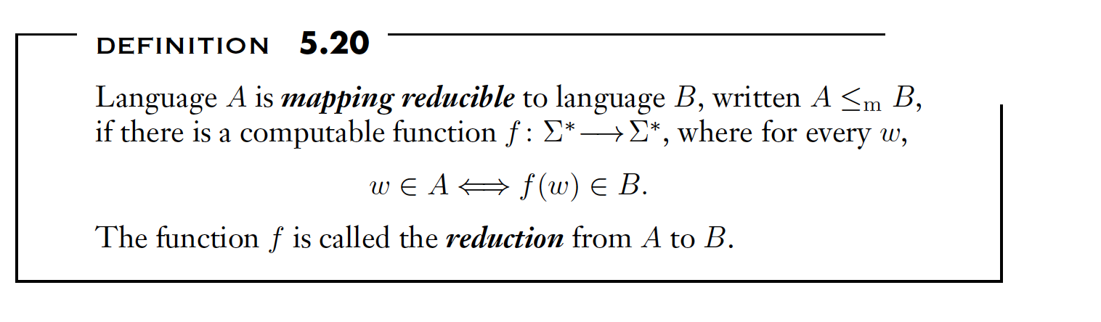
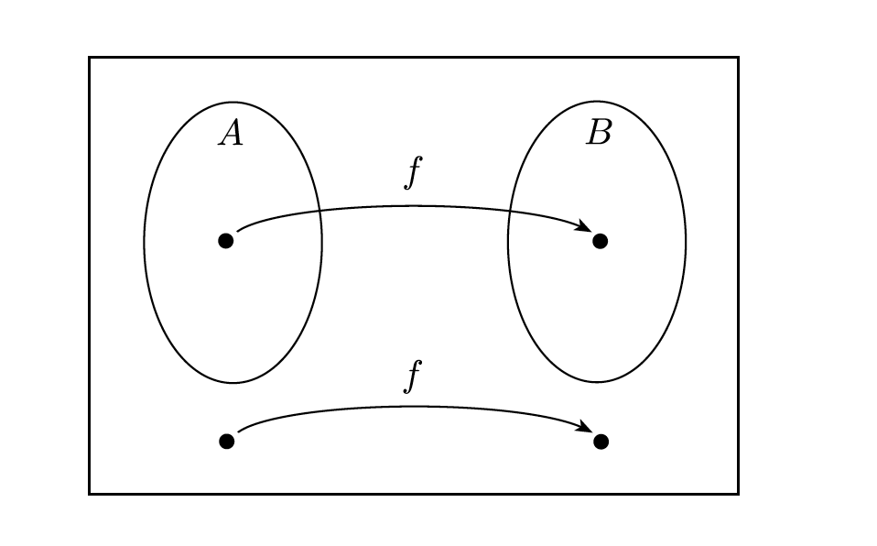
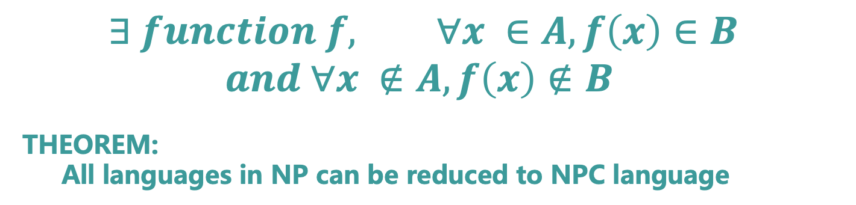
Reduction
$$∃ function f, ∀x ∈A, f\left(x\right)∈B$$
$$and ∀x ∉A, f\left(x\right)∉B$$
THEOREM:
All languages in NP can be reduced to NPC language

Slide 14
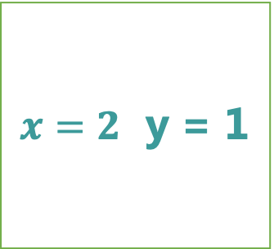
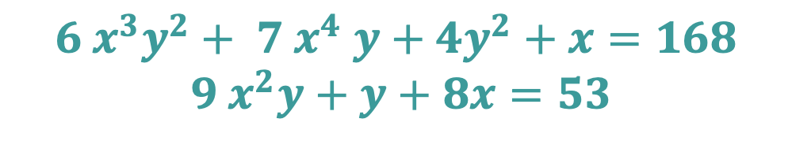
Review of ZKP
nothing except that he/she knows
one solution for this equation set
Prover
Verifier
$x=2$ y = 1
$${6 x}^{3}y^{2}+ 7 x^{4} y+{4y}^{2}+x=168$$
$$9 x^{2}y+y+8x=53$$
Ok， I trust you.

Slide 15
Review of ZKP
Prover
Hamiltonian path problem
(NPC)
Verifier

Slide 16
Review of ZKP
Prover
Circuit satisfiability problem
(NPC)
Verifier
[GMW’86]: Proofs that yield nothing but their validity or all languages in NP have zero-knowledge proof systems

Slide 17
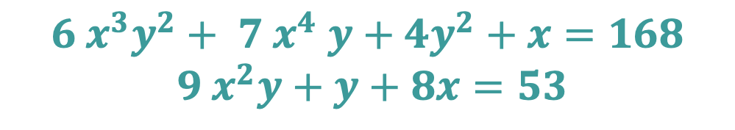
Review of ZKP
Circuit satisfiability
problem
Equation set
$${6 x}^{3}y^{2}+ 7 x^{4} y+{4y}^{2}+x=168$$
$$9 x^{2}y+y+8x=53$$
Reduce

Slide 18
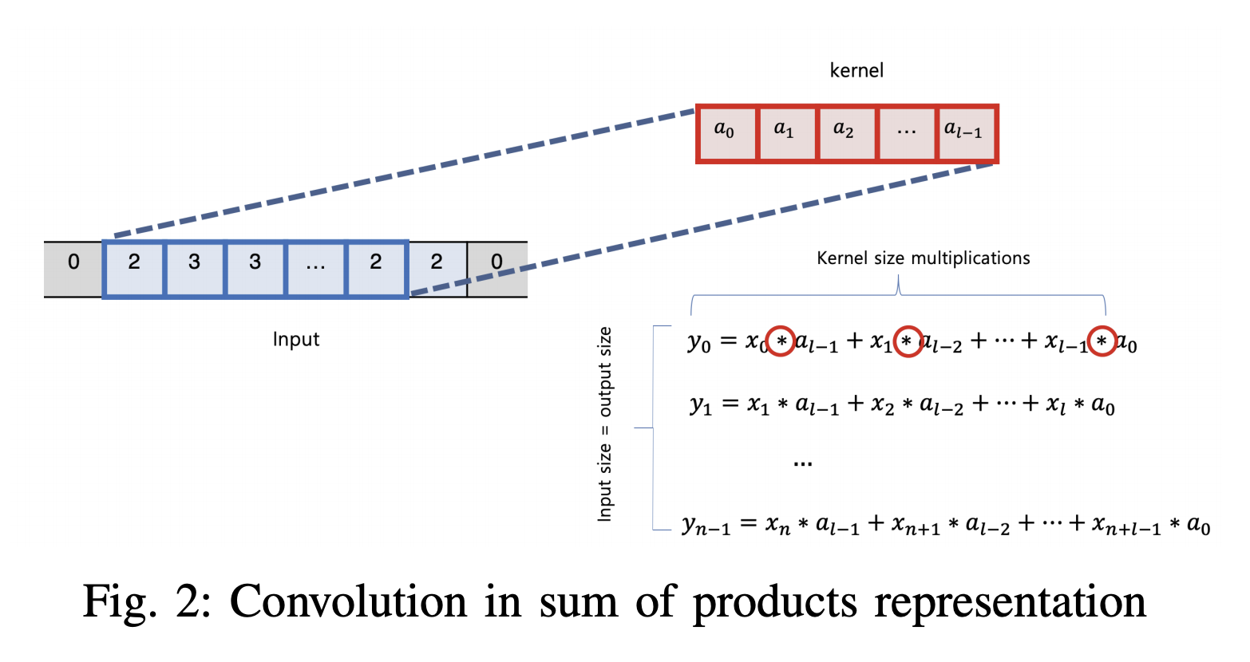
Convolutional Neural Network

Slide 19
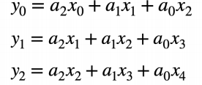
Methods in vCNN
Circuit satisfiability
problem
Reduce

Slide 20
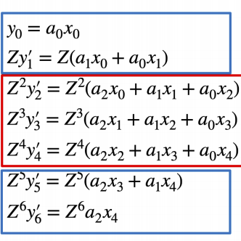
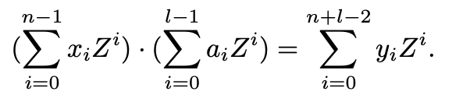
Methods in vCNN
Language B:
Statement: y2’, y3’, y4’
Witness: a0, a1, a2, x0, x1, x2, x3, x4
Relations:
Language A:
Statement: y0, y1, y2
Witness: a0, a1, a2, x0, x1, x2, x3, x4
Relations:
y0 = a2 * x0 + a1 * x1 + a0 * x2
y1 = a2 * x1 + a1 * x2 + a0 * x3
y2 = a2 * x2 + a1 * x3 + a0 * x4
(1)
(2)

Slide 21
Methods in vCNN
Reduce
Language A
Language B
(X² + X + 1) * (X + 1)
Language C
*
Reduce
X² + X +1
X +1

Slide 22
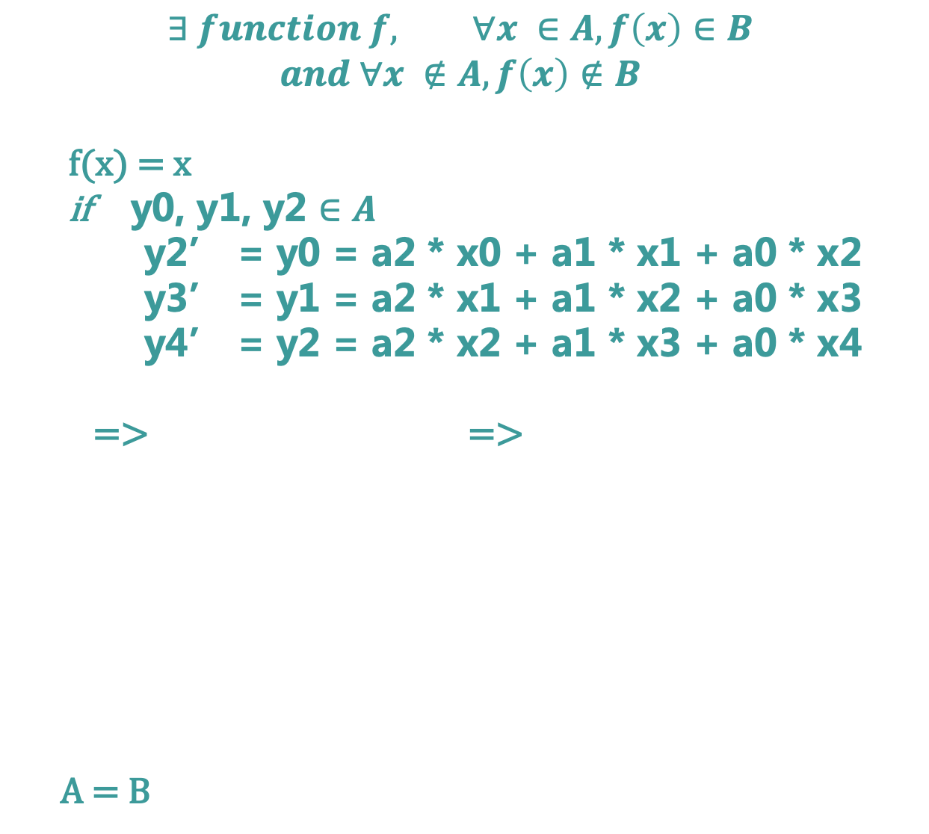
Methods in vCNN
$$∃ function f, ∀x ∈A, f\left(x\right)∈B$$
$$and ∀x ∉A, f\left(x\right)∉B$$
f(x) = x
if y0, y1, y2 $∈A$
y2’ = y0 = a2 * x0 + a1 * x1 + a0 * x2
y3’ = y1 = a2 * x1 + a1 * x2 + a0 * x3
y4’ = y2 = a2 * x2 + a1 * x3 + a0 * x4
=> =>
A = B

Slide 23
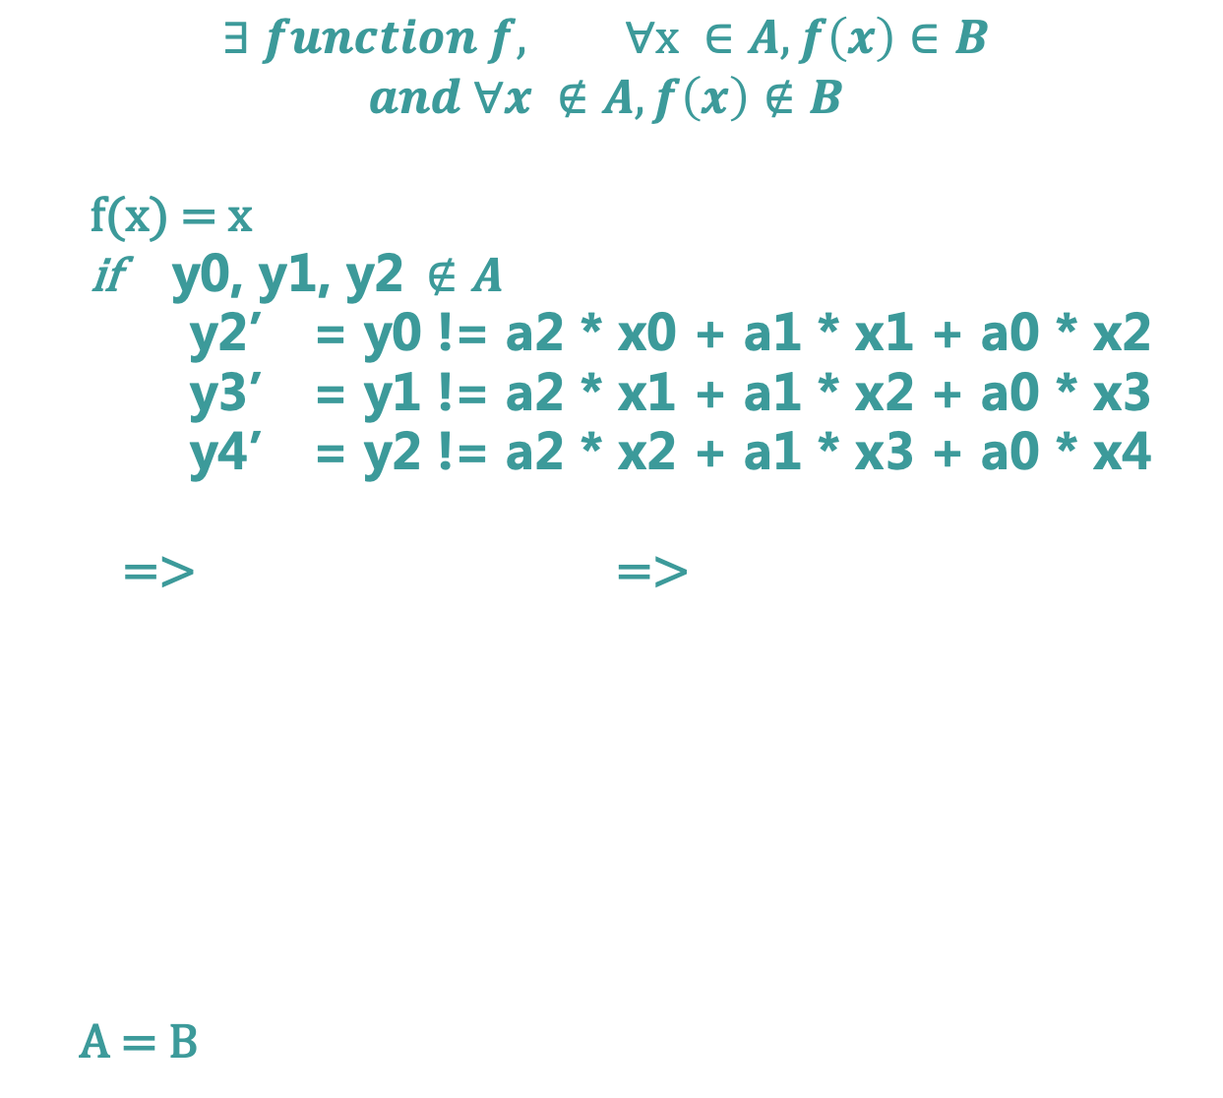
Methods in vCNN
$$∃ function f, ∀x ∈A, f\left(x\right)∈B$$
$$and ∀x ∉A, f\left(x\right)∉B$$
f(x) = x
if y0, y1, y2$∉A$
y2’ = y0 != a2 * x0 + a1 * x1 + a0 * x2
y3’ = y1 != a2 * x1 + a1 * x2 + a0 * x3
y4’ = y2 != a2 * x2 + a1 * x3 + a0 * x4
=> =>
A = B
A = B

Slide 24
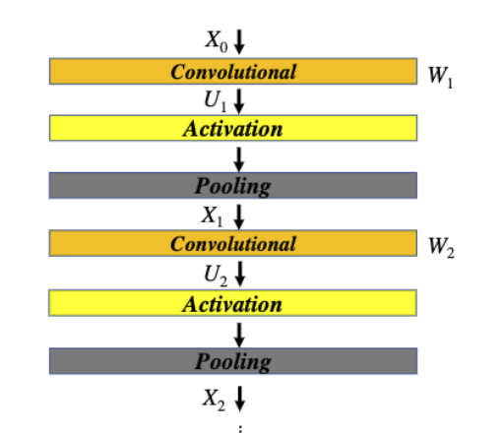

Methods in vCNN
$$<−−−−−$$
(X² + X + 1) * (X + 1)
Language C
*
Reduce
X² + X +1
X +1

Slide 25

Methods in vCNN
Circuit satisfiability
problem
$$<−−−−−$$
$$<−−−−−$$
Reduce

Slide 26
Methods in vCNN
Circuit satisfiability
problem
(X² + X + 1) * (X + 1)
Language C
*
X² + X +1
X +1
LegoSNARK: Modular Design and Composition of Succinct Zero-Knowledge Proofs (CCS’19)

Slide 27
vCNN: Verifiable Convolutional Neural
Network based on zk-SNARKs
汇报人：陆涛

